Slide 1
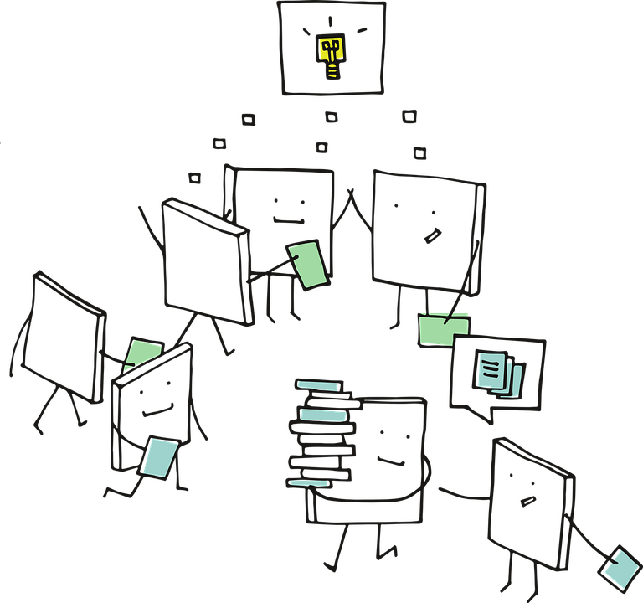
Statistical NLP

Slide 2
Understanding NLP
Tokenization
Vectorization
Text Processing & Wrangling
Word2Vec Embeddings

Slide 3
Parts of Speech
(PoS) tagging
Dependency
Parsing
Named Entity Recognition (NER)

Slide 4
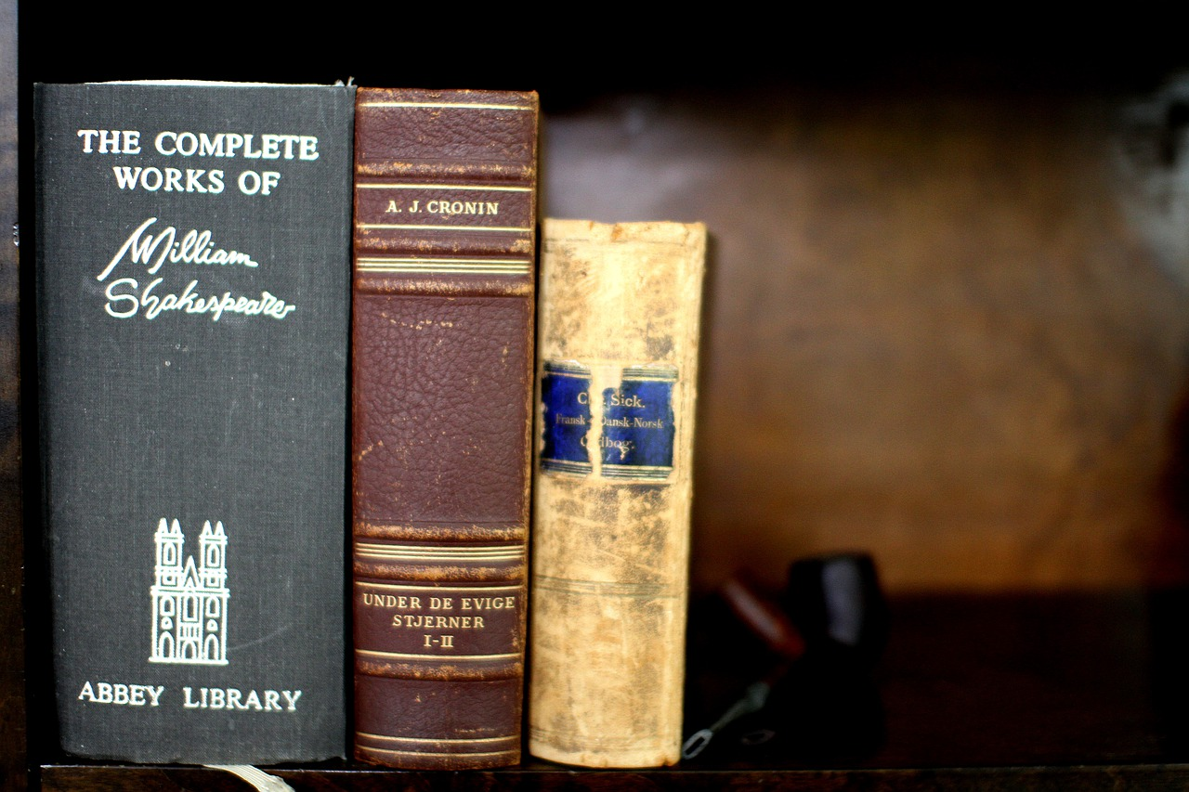
Natural Language Processing
(NLP)
.. a sub-field of AI with focus on enabling machines to understand and process human languages

Slide 5
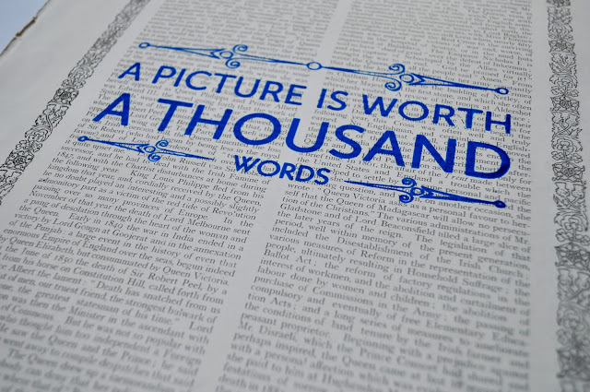
NLP vs Computer Vision
Extracting meaning out of Language data in general is more complex than Vision data

Slide 6
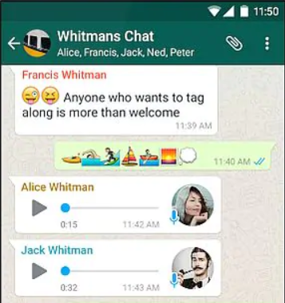
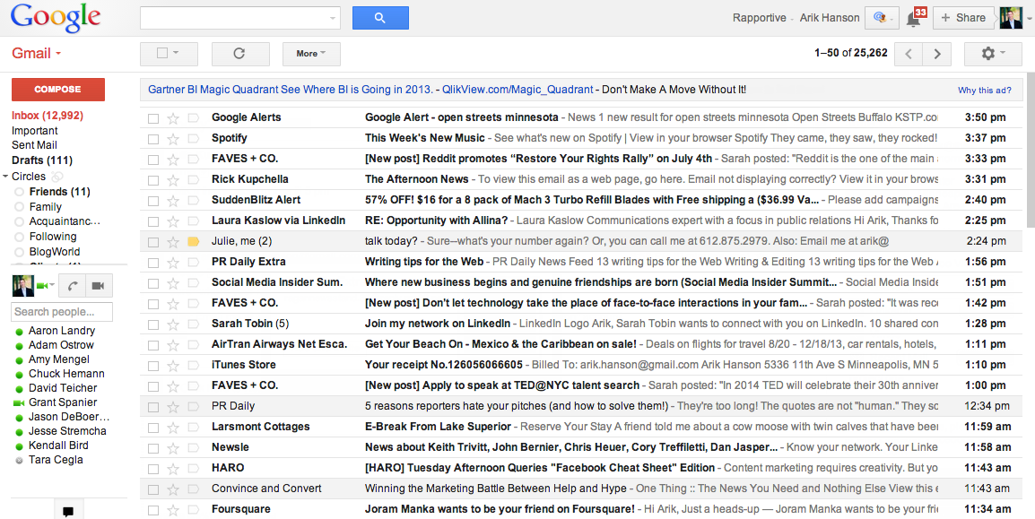
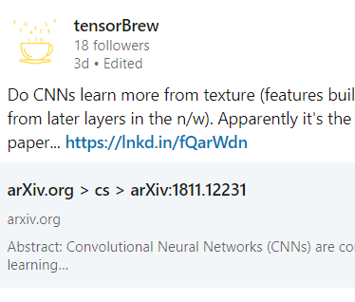
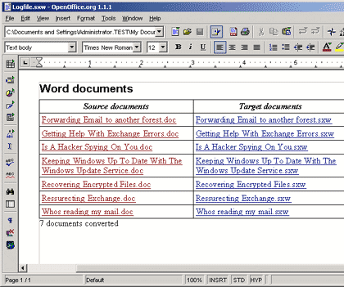

Emails
Social Media Updates
Chat interactions
Office documents
...other audio data
Some examples of Language Data

Slide 7

NLP presents a huge opportunity...
Most organization have humongous amount of textual data but struggling to get value out of it.

Slide 8
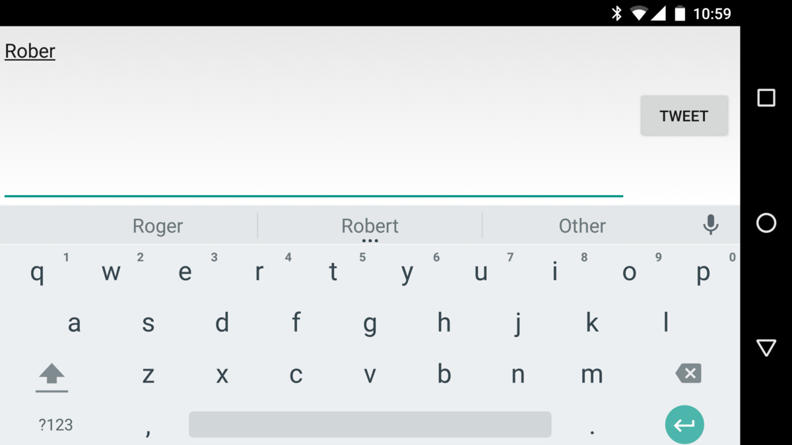
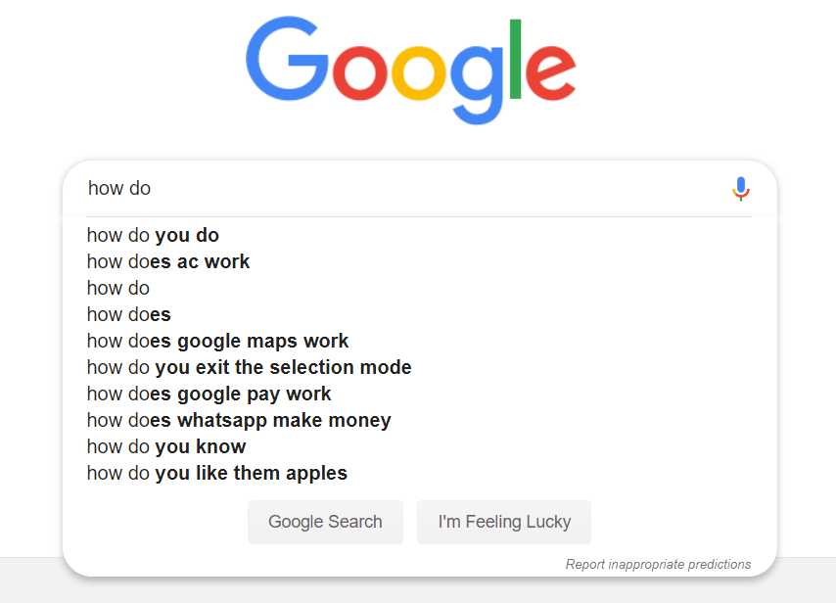

Search words prediction
Mobile phone keyboard
Sentiment analysis
Some NLP based solutions

Slide 9

Conversational agents e.g Alexa, Siri
Some NLP based solutions

Slide 10
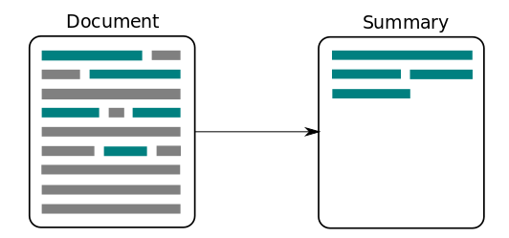
Text summarization
Some NLP based solutions

Slide 11
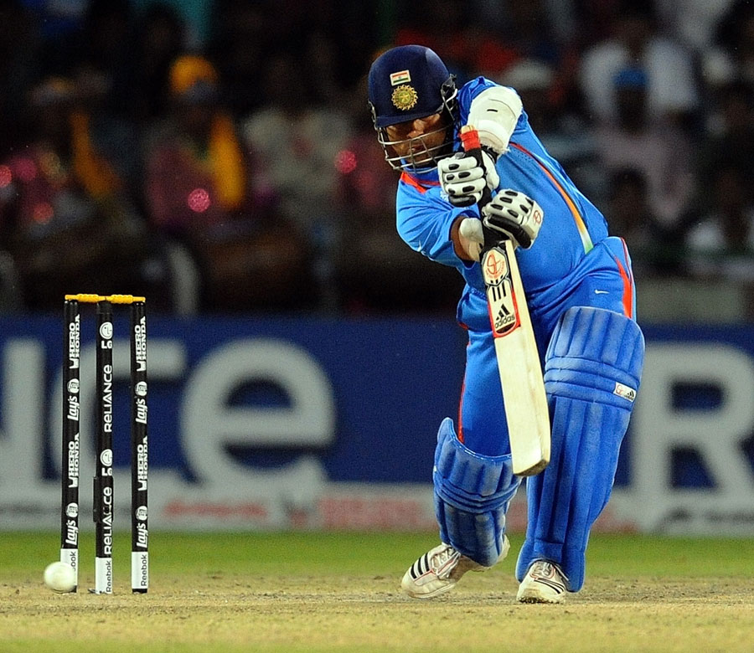
Describe picture
Tendulkar playing cricket
Some NLP based solutions

Slide 12
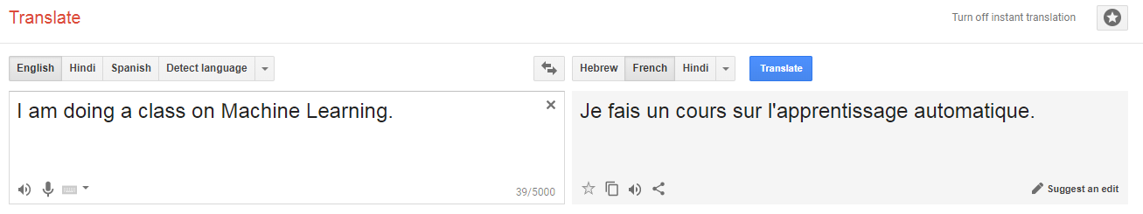
Language translation
Some NLP based solutions

Slide 13
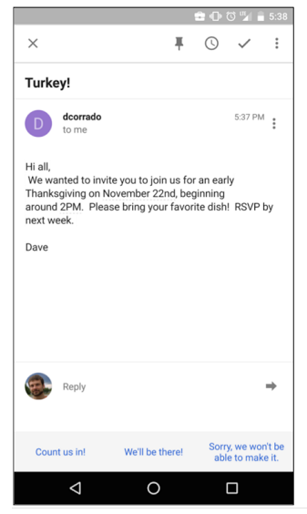
Email Response
Suggested Answers

Slide 14

Working with Textual Data

Slide 15
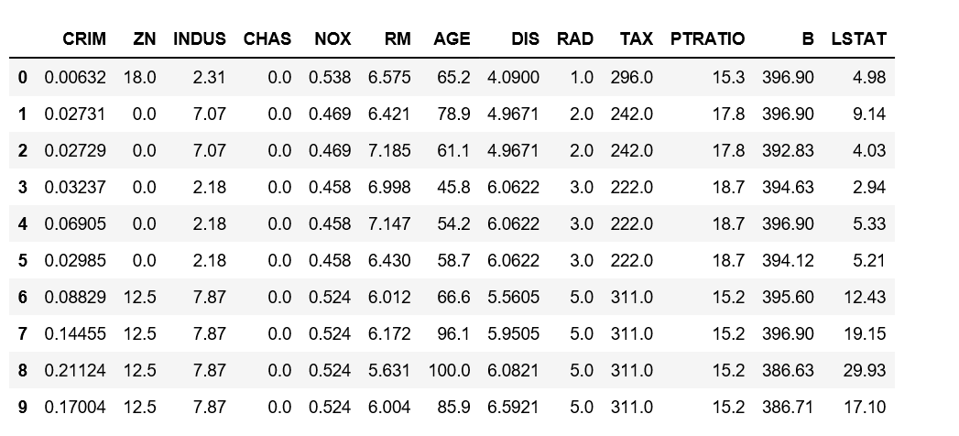
Structured Data
has features (columns)
All records have same features
Features maintain order across examples
Boston Housing Price dataset

Slide 16

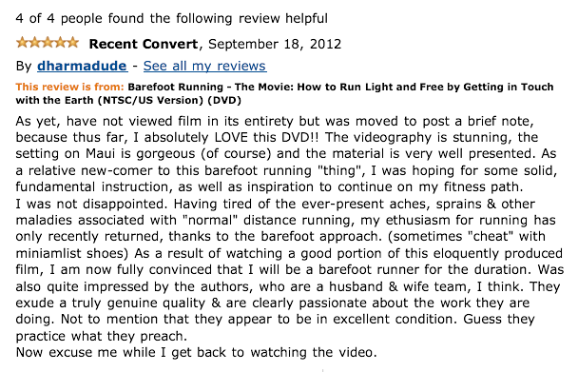
Textual Data
Do not have features like in tabular data.
Examples usually have different size.

Slide 17

What could be the features of textual Data?

Slide 18
Features in textual Data
Words?
Characters?
Combination of words (n-grams)?
Sentences?
What else?

Slide 19
Text Data
“Hyderabad is the capital of Telangana.”
‘Hyderabad’, ‘is’, ‘the’, ‘capital’, ‘of’, ‘Telangana’, ’.’
Tokenization
Breaking text into tokens e.g words, chars etc

Slide 20
ML Model
Text Data as tokens
‘Hyderabad’, ‘is’, ‘the’, ‘capital’, ‘of’, ‘Telangana’, ’.’
Math works with numbers

Slide 21
ML Model
Text Data as tokens
‘Hyderabad’, ‘is’, ‘the’, ‘capital’, ‘of’, ‘Telangana’, ’.’
Convert Text to Numbers
Vectorization
Converting each token into number(s)

Slide 22

How to convert text into Numbers

Slide 23
Build Vocabulary
Unique words in entire dataset
Document #1
Document #2
He is a good boy. She is also good.
Radhika is a good person.
Vocabulary
a, also, boy, good, He, is, person, She, Radhika
In this case, we have 2 examples and 9 unique words!

Slide 24
Document #1
Document #2
He is a good boy. She is also good.
Radhika is a good person.
Vocabulary
a, also, boy, good, He, is, person, She, Radhika
 | a | also | boy | good | He | Is | person | She | Radhika
Index | 0 | 1 | 2 | 3 | 4 | 5 | 6 | 7 | 8
Assign index for each word in vocabulary

Slide 25
How to convert individual documents into numbers using index and vocabulary?
We have multiple approaches …
Bag of words
Count Vectorizer
TF-IDF Vectorizer

Slide 26

Bag of Words
A simple feature extraction approach in NLP
Ignores grammar / structure
Represents each document by measuring presence of vocabulary words
Words

Slide 27
Document #1
Document #2
He is a good boy. She is also good.
Radhika is a good person.
Vocabulary
a, also, boy, good, He, is, person, She, Radhika
 | a | also | boy | good | He | Is | person | She | Radhika
Index | 0 | 1 | 2 | 3 | 4 | 5 | 6 | 7 | 8
Document# 1
Check if each word in Vocabulary appears in Document #1

Slide 28
Document #1
Document #2
He is a good boy. She is also good.
Radhika is a good person.
Vocabulary
a, also, boy, good, He, is, person, She, Radhika
 | a | also | boy | good | He | Is | person | She | Radhika
Index | 0 | 1 | 2 | 3 | 4 | 5 | 6 | 7 | 8
Document #1 | 1 | 1 | 1 | 1 | 1 | 1 | 0 | 1 | 0
Indicate ‘1’ if word was found, otherwise indicate ‘0’

Slide 29
Document #1
Document #2
He is a good boy. She is also good.
Radhika is a good person.
Vocabulary
a, also, boy, good, He, is, person, She, Radhika
 | a | also | boy | good | He | Is | person | She | Radhika
Index | 0 | 1 | 2 | 3 | 4 | 5 | 6 | 7 | 8
Document #1 | 1 | 1 | 1 | 1 | 1 | 1 | 0 | 1 | 0
Document #2 | 1 | 0 | 0 | 1 | 0 | 0 | 1 | 0 | 1

Slide 30
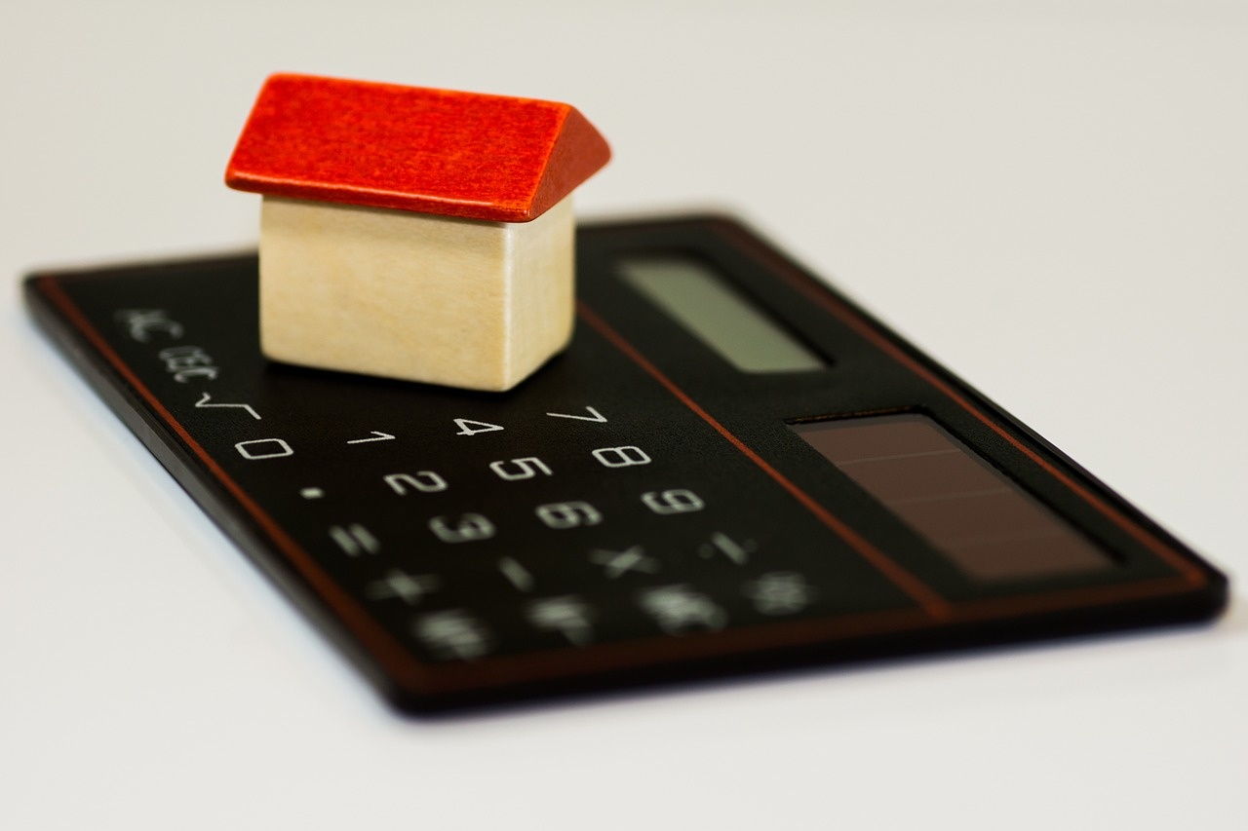
Count
Vectorizer

Slide 31
Document #1
Document #2
He is a good boy. She is also good.
Radhika is a good person.
Vocabulary
a, also, boy, good, He, is, person, She, Radhika
 | a | also | boy | good | He | Is | person | She | Radhika
Index | 0 | 1 | 2 | 3 | 4 | 5 | 6 | 7 | 8
Document# 1
Count how many times each word in Vocabulary appears in Document #1

Slide 32
Document #1
Document #2
He is a good boy. She is also good.
Radhika is a good person.
Vocabulary
a, also, boy, good, He, is, person, She, Radhika
 | a | also | boy | good | He | Is | person | She | Radhika
Index | 0 | 1 | 2 | 3 | 4 | 5 | 6 | 7 | 8
Document #1 | 1 | 1 | 1 | 2 | 1 | 2 | 0 | 1 | 0
Document #1 = [1, 1, 1, 2, 1, 2, 0, 1, 0]

Slide 33
Document #1
Document #2
He is a good boy. She is also good.
Radhika is a good person.
Vocabulary
a, also, boy, good, He, is, person, She, Radhika
 | a | also | boy | good | He | Is | person | She | Radhika
Index | 0 | 1 | 2 | 3 | 4 | 5 | 6 | 7 | 8
Document #1 | 1 | 1 | 1 | 2 | 1 | 2 | 0 | 1 | 0
Document #2 | 1 | 0 | 0 | 1 | 0 | 1 | 1 | 0 | 1
Document #2 = [1, 0, 0, 1, 0, 1, 1, 0, 1]

Slide 34
Document #1
Document #2
He is a good boy. She is also good.
Radhika is a good person.
Vocabulary
a, also, boy, good, He, is, person, She, Radhika
 | a | also | boy | good | He | Is | person | She | Radhika
Index | 0 | 1 | 2 | 3 | 4 | 5 | 6 | 7 | 8
Document #1 | 1 | 1 | 1 | 2 | 1 | 2 | 0 | 1 | 0
Document #2 | 1 | 0 | 0 | 1 | 0 | 1 | 1 | 0 | 1
Document Term Matrix (DTM)

Slide 35
TF-IDF Vector
Not just simple counting

Slide 36
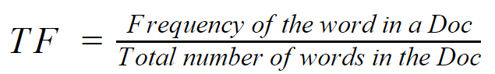
Document #1
He is a good boy. She is also good.
He | 1
is | 2
a | 1
good | 2
boy | 1
she | 1
also | 1
Total | 9
TF(He, doc#1) = 1/9 = 0.11
TF(good, doc#1) = 2/9 = 0.22
TF captures how important a word is to the document (without looking at other documents in the dataset)

Slide 37
Document #2
Radhika is a good person.
Radhika | 1
is | 1
a | 1
good | 1
person | 1
Total | 5
TF(He, doc#2) = 0/5 = 0
TF(good, doc#2) = 1/5 = 0.2

Slide 38
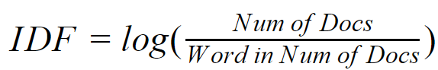
Document #1
Document #2
He is a good boy. She is also good.
Radhika is a good person.
He | 1
is | 2
a | 1
good | 2
boy | 1
she | 1
also | 1
Total | 9
Radhika | 1
is | 1
a | 1
good | 1
person | 1
Total | 5
IDF(He) = log(2/1) = 0.301
IDF(good) = log(2/2) = 0
IDF tells us if a word (feature) can be used to distinguish documents. If a word appears in majority of the documents then IDF will be close to ‘0’ i.e. give low weightage to that feature.

Slide 39
Document #1
Document #2
He is a good boy. She is also good.
Radhika is a good person.
He | 1
is | 2
a | 1
good | 2
boy | 1
she | 1
also | 1
Total | 9
Radhika | 1
is | 1
a | 1
good | 1
person | 1
Total | 5
IDF(He) = log(2/1) = 0.301
IDF(good) = log(2/2) = 0
TF-IDF(He, doc#1) = 0.11 * 0.301 = 0.03311
TF-IDF(good, doc#1) = 0.22 * 0 = 0
TF-IDF(He, doc#2) = 0 * 0.301 = 0
TF-IDF(good, doc#2) = 0.2 * 0 = 0

Slide 40
Document #1
Document #2
He is a good boy. She is also good.
Radhika is a good person.
Vocabulary
a, also, boy, good, He, is, person, She, Radhika
 | a | also | boy | good | He | Is | person | She | Radhika
Index | 0 | 1 | 2 | 3 | 4 | 5 | 6 | 7 | 8
Document #1 |  |  |  | 0 | 0.03311
Document #2 |  |  |  | 0 | 0
TF-IDF Vector

Slide 41
SMS Classification: Ham or Spam
Exercise

Slide 42

Exercise: Sentiment Analysis

Slide 43

Text Processing

Slide 44
Stopwords Removal
The
You
High frequency words i.e present in most documents
Can not be used to distinguish between documents
Hence can be removed as features
and
a

Slide 45
Lemmatization
Liking
Converts inflections to root word or Lemma
Used for dimensionality reduction
Word stem usually present in dictionary
Likes
Like
Liked
Likely
Root Word or Lemma
Inflections

Slide 46
Stemming
Liking
Converts inflections to root or word stem
Word stem may not be present in dictionary
Popular algorithms include Potter Stemmer, Lovins Stemmer etc
Likes
Lik
Liked
Likely
Word stem
Inflections

Slide 47
Stemming & Lemmatization using NLTK
Exercise

Slide 48

Working with Web Data
Using Beautiful Soup

Slide 49
I had washed my house.
I had my house washed.
Exact same words.. but different meaning.
Why?

Slide 50
Bag of words (CountVectorizer, Tf-IDF) does not keep order of words and hence can not be used to understand the meaning of the text.

Slide 51
How to keep word sequence intact during Vectorization?
One hot encoding
Word2Vec

Slide 52
Understanding
Language Structure & Syntax

Slide 53
She saw a bear.
Your efforts will bear fruit.
How the word ‘bear’ different in two sentences?

Slide 54
Noun
Verb
She saw a bear.
Your efforts will bear fruit.
How the word ‘bear’ different in two sentences?

Slide 55
Information Retrieval
Hyderabad is the capital of the Indian state of Telangana occupying 650 square kilometres (250 sq mi) along the banks of the Musi River. Hyderabad City has a population of about 6.9 million, making it the fourth-most populous city in India.
Established in 1591 by Muhammad Quli Qutb Shah, Hyderabad remained under the rule of the Qutb Shahi dynasty for nearly a century before the Mughals captured the region.
Hyderabad
Capital of ?
How populated is Hyderabad?
Who established Hyderabad?

Slide 56
Part-of-Speech (POS) Tagging
Assign grammatical properties (e.g. noun, verb, adverb, adjective etc.) to words.
Allows understanding of language structure and syntax.
These properties can used to extract information by using language rules.
Multiple NLP libraries support POS tagging e.g. NLTK, spaCy

Slide 57
Part-of-Speech (POS) Tagging
Hyderabad
Is
..
Telangana
ML Model
POS Tagging
POS tagging is done using a trained ML Model

Slide 58
How are the words in a sentence related to each other?

Slide 59
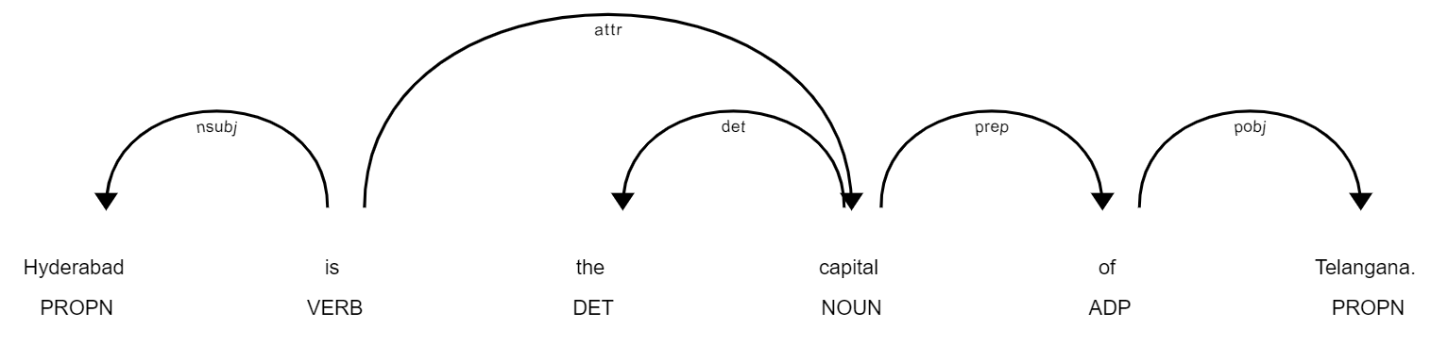
Dependency Parsing
Shows how words in a sentence relate to each other.
Allows further understanding of language structure and syntax.

Slide 60
Named Entity Recognition (NER)
Barack Obama is an American politician who served as the 44th President of the United States from 2009 to 2017. He is the first African American to have served as president, as well as the first born outside the contiguous United States.
Classifies text into predefined categories or real world entities.
Used for information extraction, improve search algorithms, content recommendations.

Slide 61
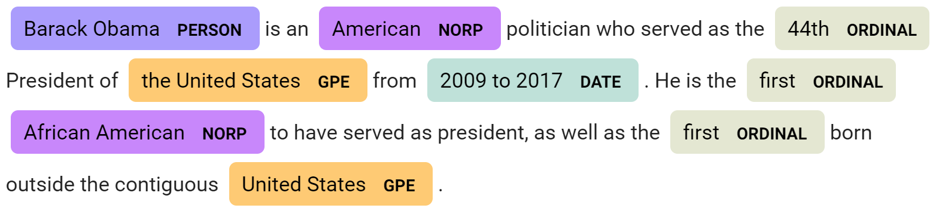
Named Entity Recognition (NER)
Classifies text into predefined categories or real world entities.
Used for information extraction, improve search algorithms, content recommendations.

Slide 62
PoS Tagging, Dependency Parsing & Named Entity Recognition
Using spaCy

